Slide 1
AI
PROJECT P2
Venceslas KOUASSI
Lucas BONMARIN

Slide 2
TOPIC
2
Unsupervised Learning
Nonnegative Matrix Factorization (NMF)

Slide 3
PLAN
3
NMF : WHAT IS IT ?
DIFFICULTIES IN NMF
NMF : SOME APPLICATIONS

Slide 4
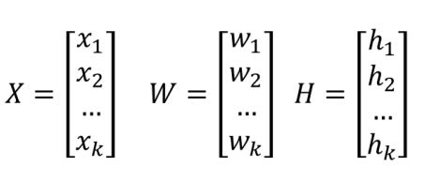
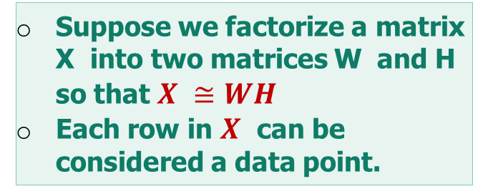
NMF : WHAT IS IT?
4
NMF (Nonnegative Matrix Factorization) is a matrix factorization method where we constrain the matrices to be nonnegative.
Suppose we factorize a matrix X into two matrices W and H so that $X ≅WH$
Each row in $X$ can be considered a data point.
Source : [1]

Slide 5
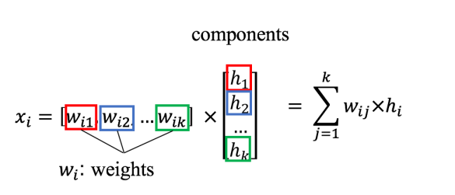
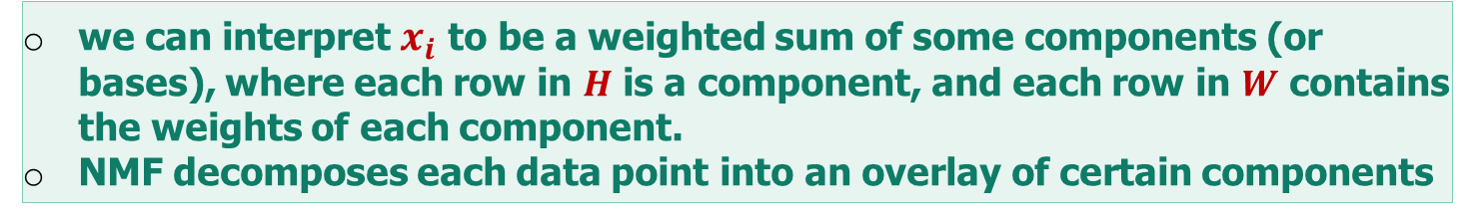
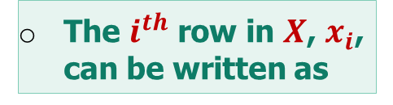
NMF : WHAT IS IT?
5
The $i^{th}$ row in $X$, $x_{i}$, can be written as
Source : [1]
we can interpret $x_{i}$ to be a weighted sum of some components (or bases), where each row in $H$ is a component, and each row in $W$ contains the weights of each component.
NMF decomposes each data point into an overlay of certain components

Slide 6
NMF : WHAT IS IT?
6
Formalization of an objective function and iterative optimization.
NMF is an NP-hard problem in general local minima.
Although there are some variants, a generally used measures of distance is the frobenius norm (the sum of element-wise squared errors).
$$minimize{ \left\|X−WH\right\|}_{F}^{2} w.r.t. W,H s.t. W,H ≥0$$

Slide 7
DIFFICULTIES IN NMF
7
Choice of Suitable Model order K : number of rank-1 matrices within the approximation.
Data fitting / Model complexity tradeoff : A greater K leads to a better data approximation /A smaller K leads to a less complex model (easier to estimate, less
parameters, etc ...)
Ill-posed Problem : The solution is not unique

Slide 8
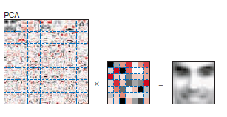
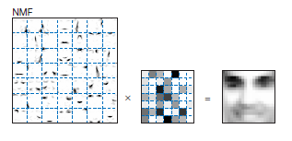
NMF : SOME APPLICATIONS
8
Face decomposition : Comparison with PCA
PCA (Principle Components Analysis) is a factorization method that creates both positive and negative factors
Topic Modeling : yield components that could be considered “topics”, and decompose term-document matrix into a weighted sum of topics

Slide 9

CONCLUSION
END
17

Slide 10
REFERENCES
8
Topic Modeling with Scikit Learn, https://medium.com/mlreview/topic-modeling-with-scikit-learn-e80d33668730
A Practical Introduction to NMF (nonnegative matrix factorization, http://mlexplained.com/2017/12/28/a-practical-introduction-to-nmf-nonnegative-matrix-factorization/
A tutorial on nonnegative matrix Factorisation with applications to AUDIOVISUAL CONTENT analysis, https://perso.telecom-paristech.fr/essid/teach/NMF_tutorial_ICME-2014.pdf

